Slide 1
GLOBAL EXCHANGE PROGRAMME: 2025-26
LOWER KINDERGARTEN (LKG)

Slide 2


Slide 3



Slide 4

ACTIVITY: 1
INTERNATIONAL DAY OF FRIENSHIP.

Slide 5
BIRLA HIGH SCHOOL, KOLKATA

Slide 6
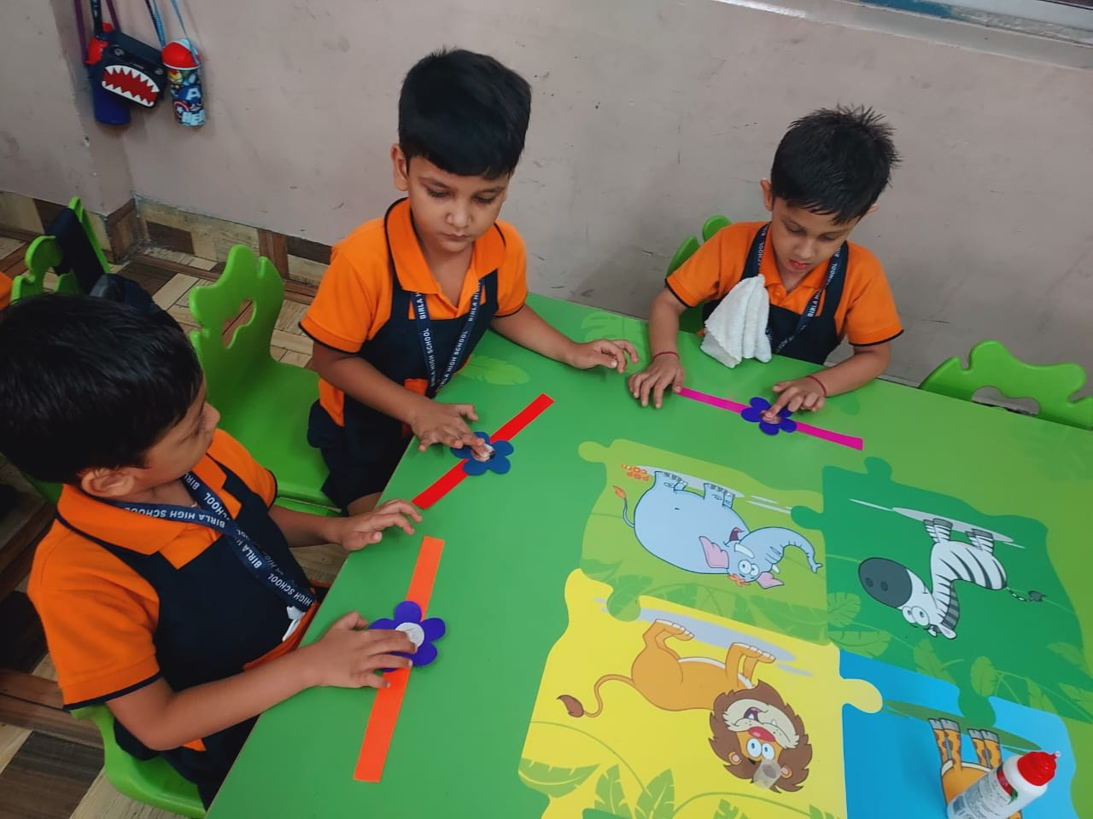
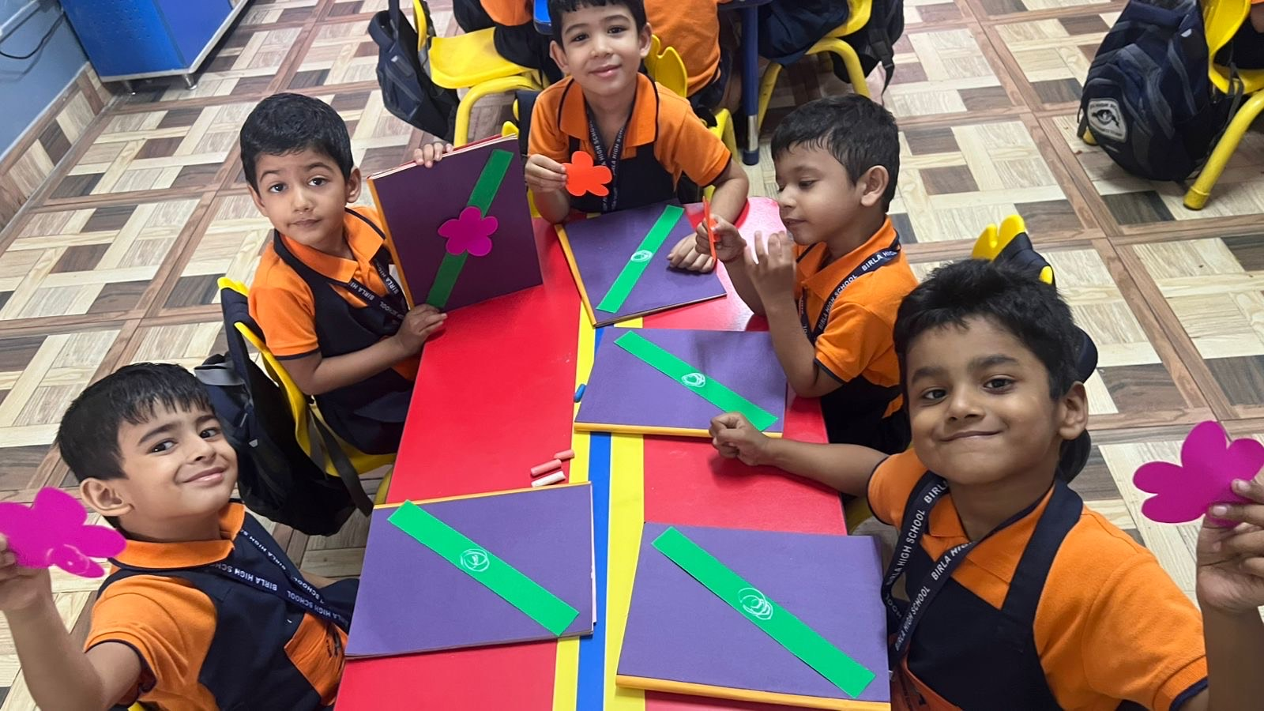
Creating little tokens of love for big friendships!

Slide 7
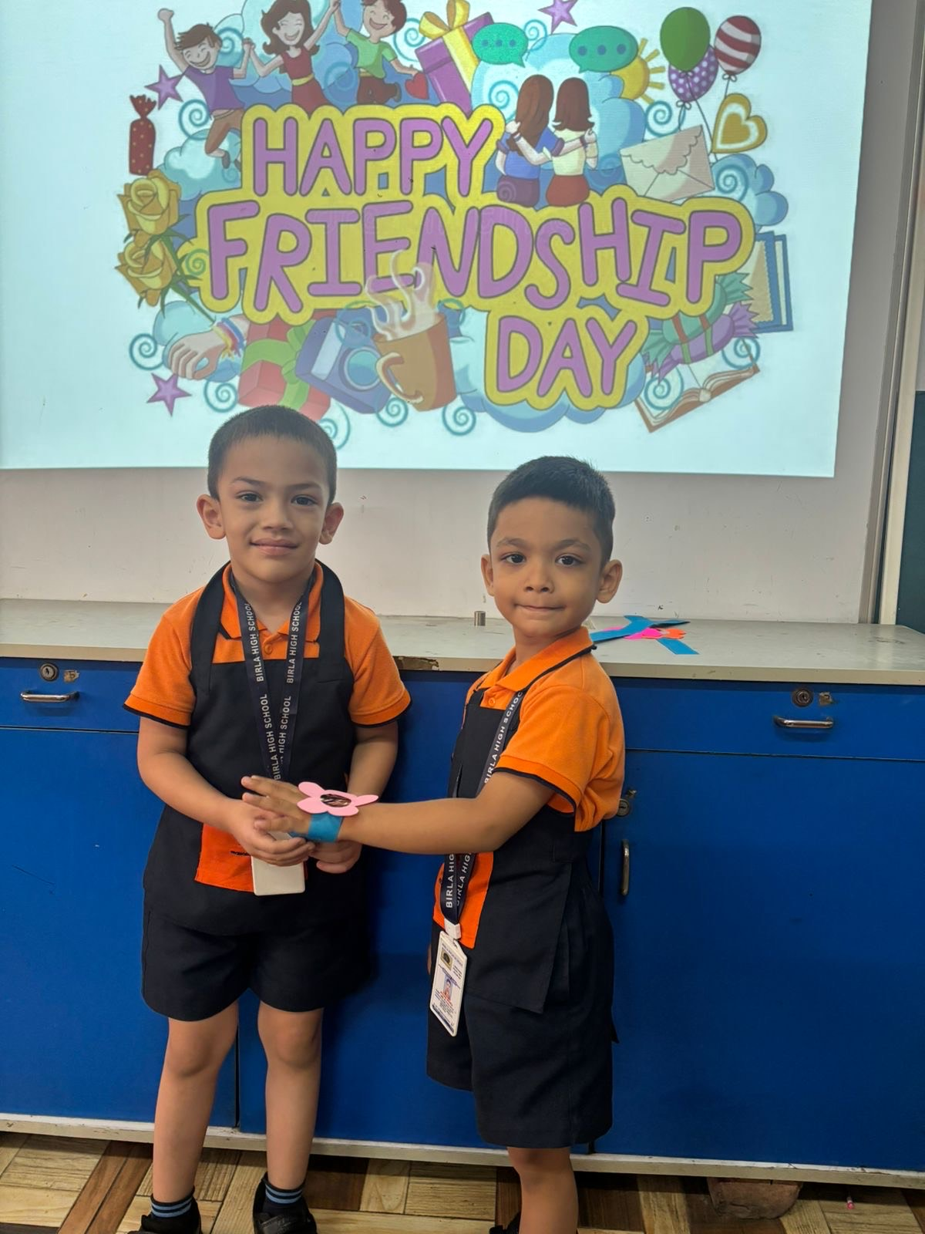
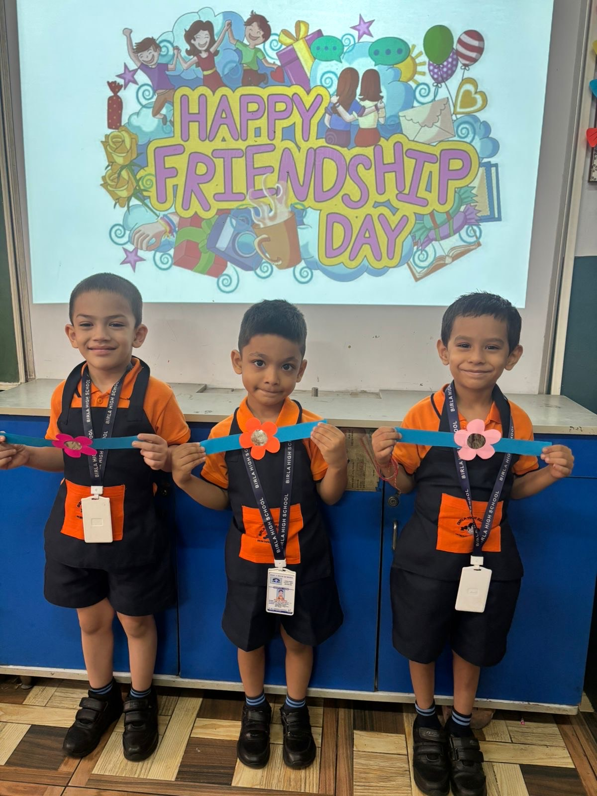
Friendship Day magic in every knot!

Slide 8
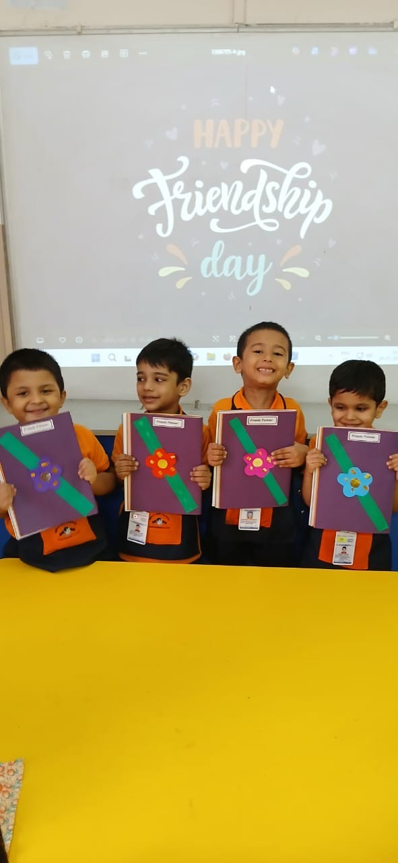
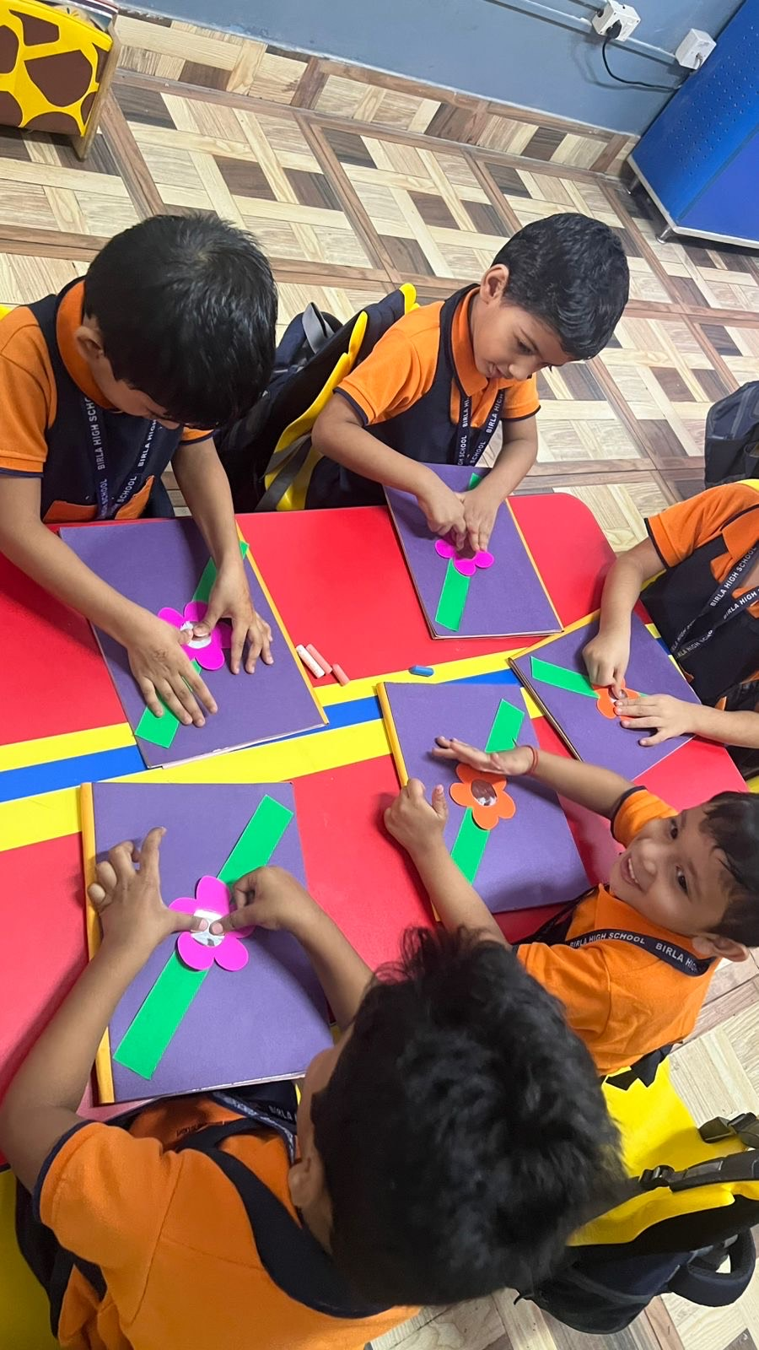
A band of cheer, to hold friends near!

Slide 9
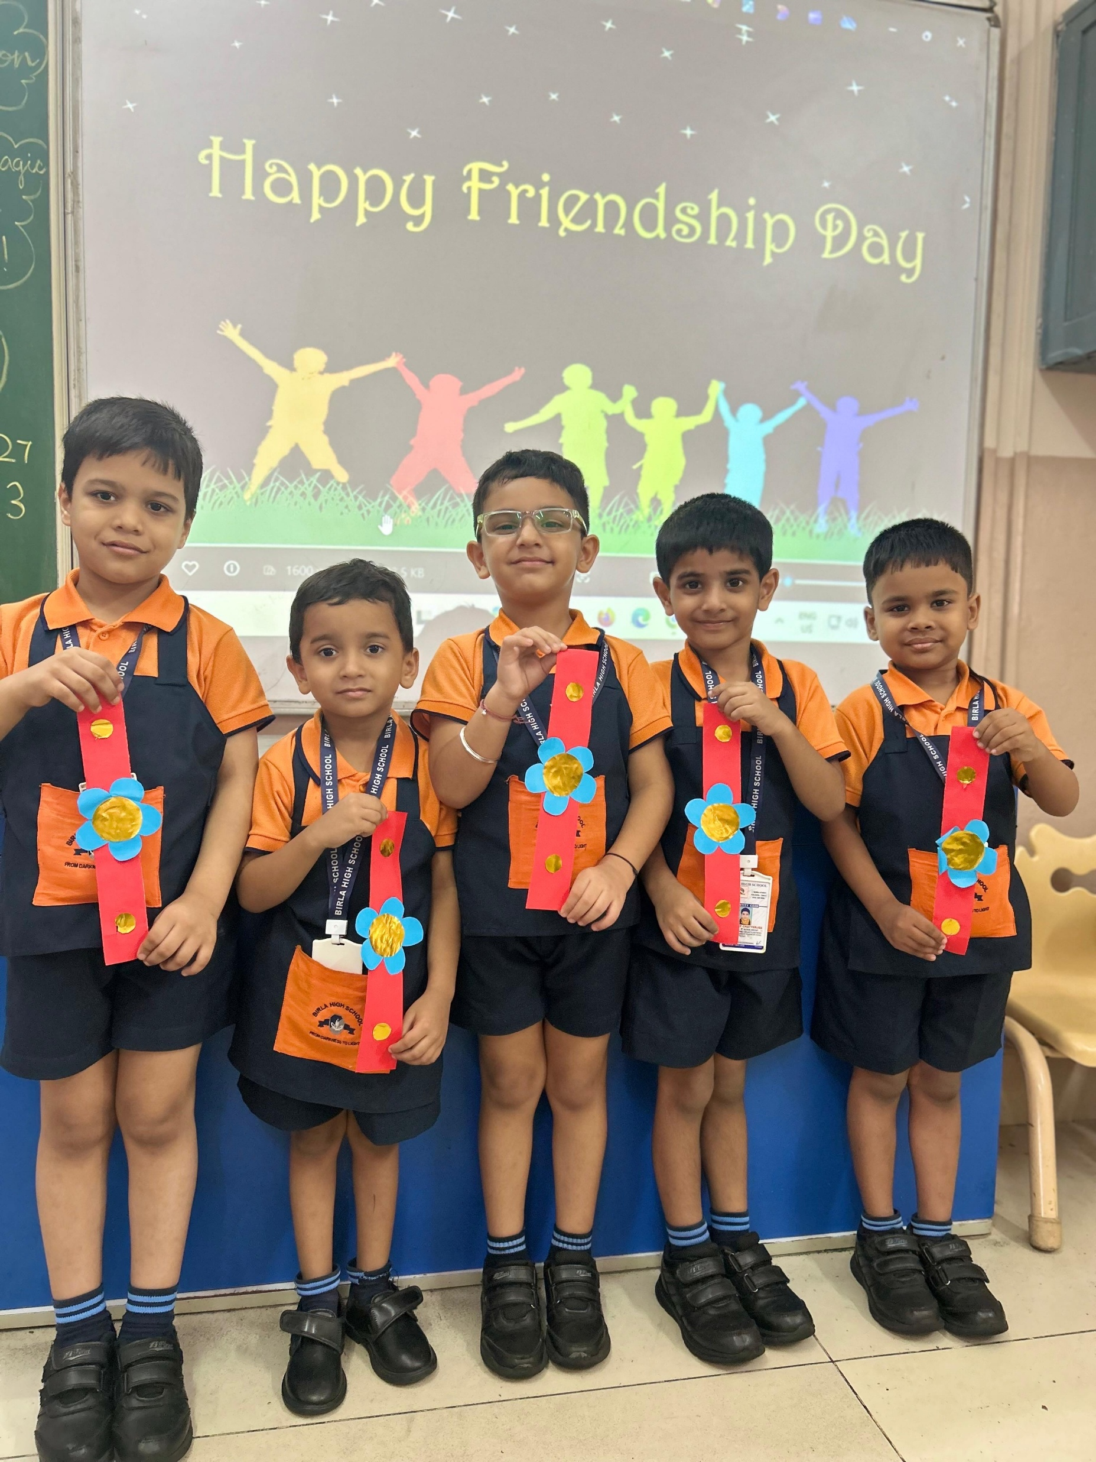
A colourful bond that brings us closer!

Slide 10
